Slide 1
Multi-agent behavior
Emily Mackevicius
Analysis for Neuroscience
Oct 16, 2023

Slide 2
Plan
Motivate multi-agent behavior
Demos and exercises
Simulate
Visualize
Reasoning
Abstraction and AI as a tool

Slide 3
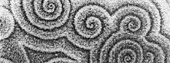
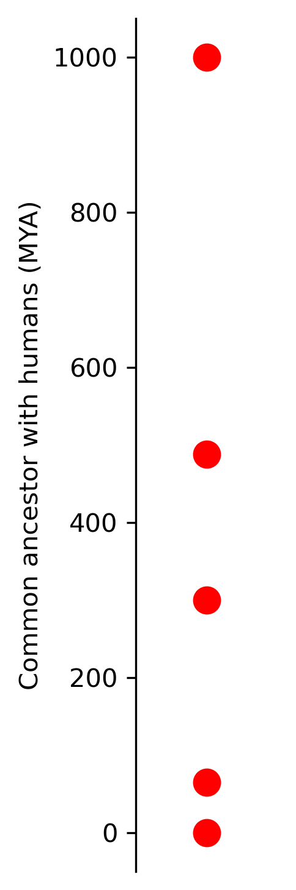
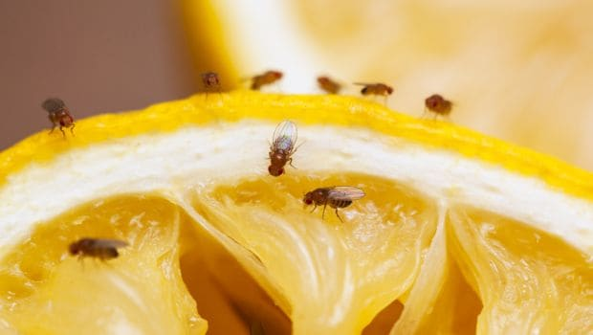
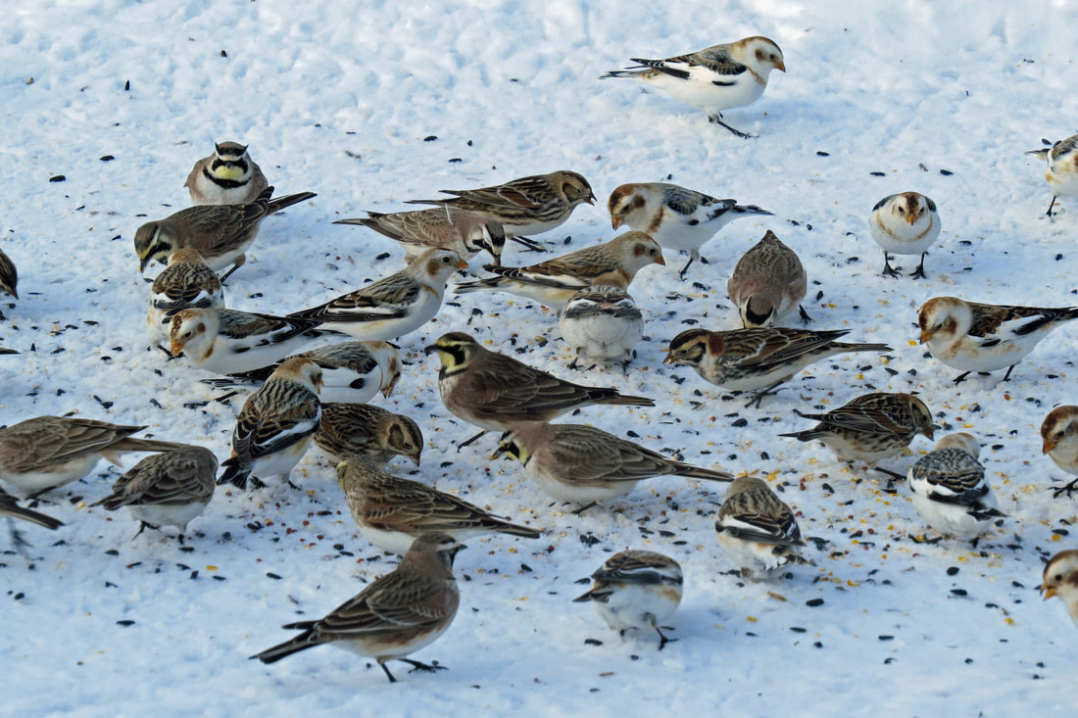
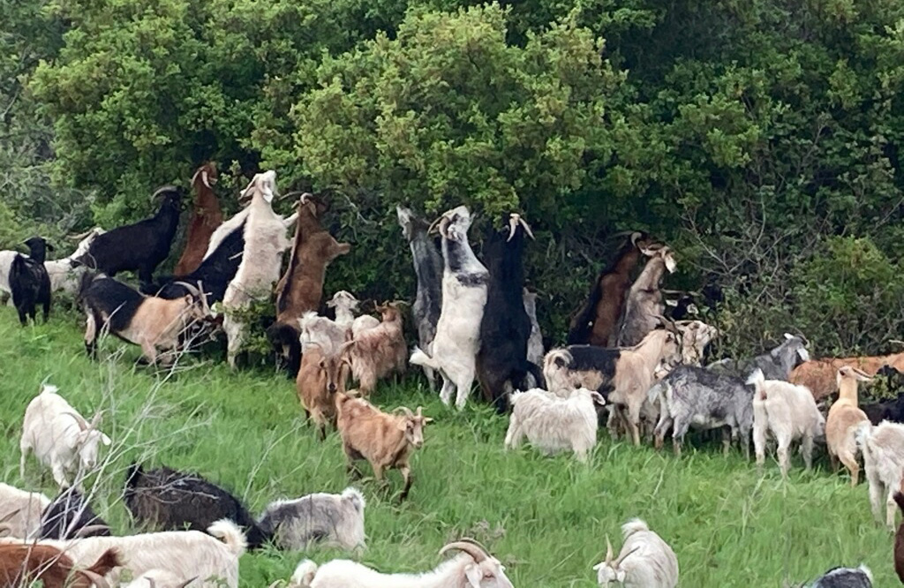
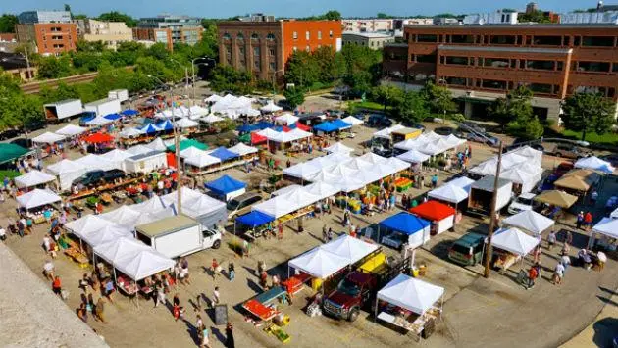
Notes:
http://abacus.gene.ucl.ac.uk/will/files/TreeOfLife.pdf
import matplotlib.pyplot as plt
import numpy as np
# Data points
years_ago = [1000, 488, 300, 65, .2]
# Plotting
fig, ax = plt.subplots(figsize=(1,6))
ax.plot([years_ago], 'ro', markersize=10) # 3700 MYA
ax.spines['top'].set_visible(False)
ax.spines['right'].set_visible(False)
ax.spines['bottom'].set_visible(False)
# ax.spines['left'].set_visible(False)
ax.xaxis.set_visible(False)
ax.set_ylabel('Common ancestor with humans (MYA)')
# Show the plot
# plt.show()
plt.savefig('/Users/emily/Downloads/plot.png', dpi=300, bbox_inches='tight')
# Close the plot
plt.close()

Slide 4
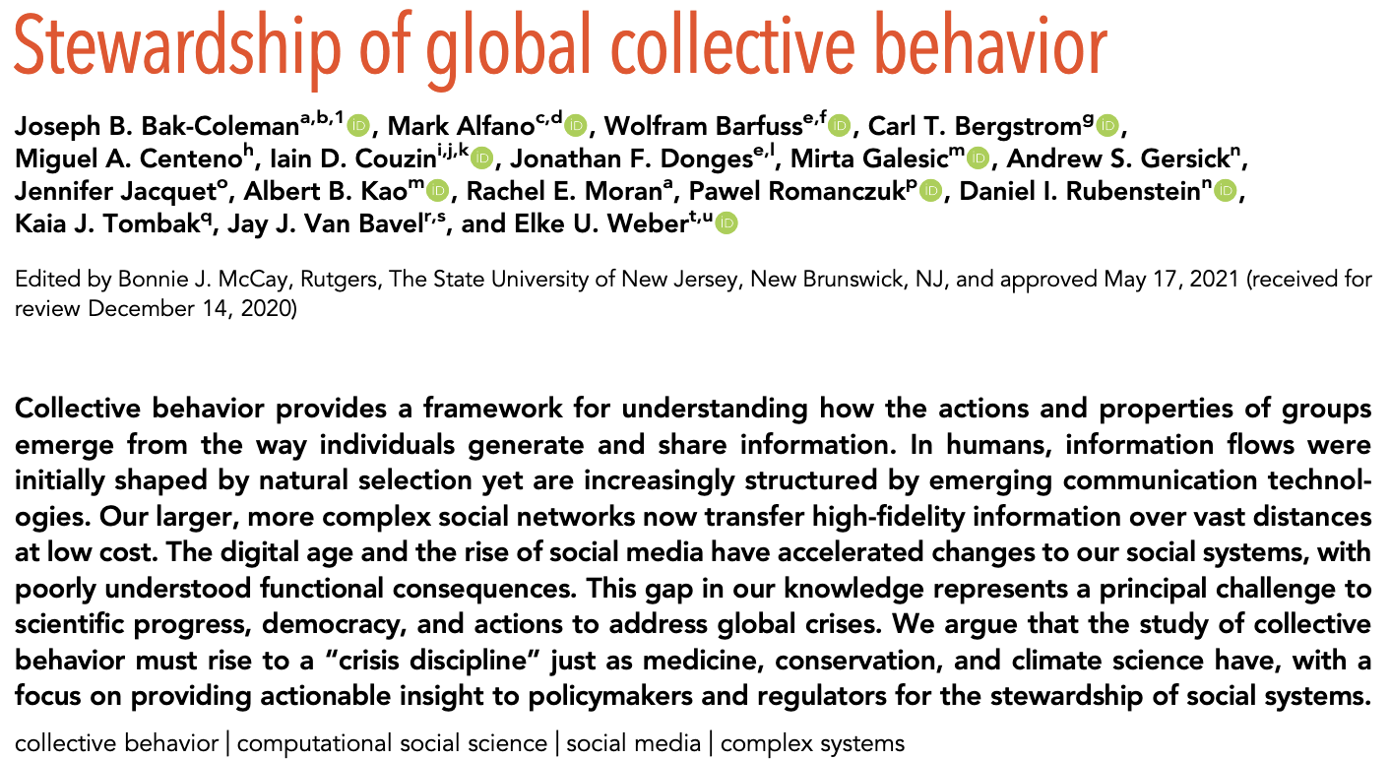

Slide 5

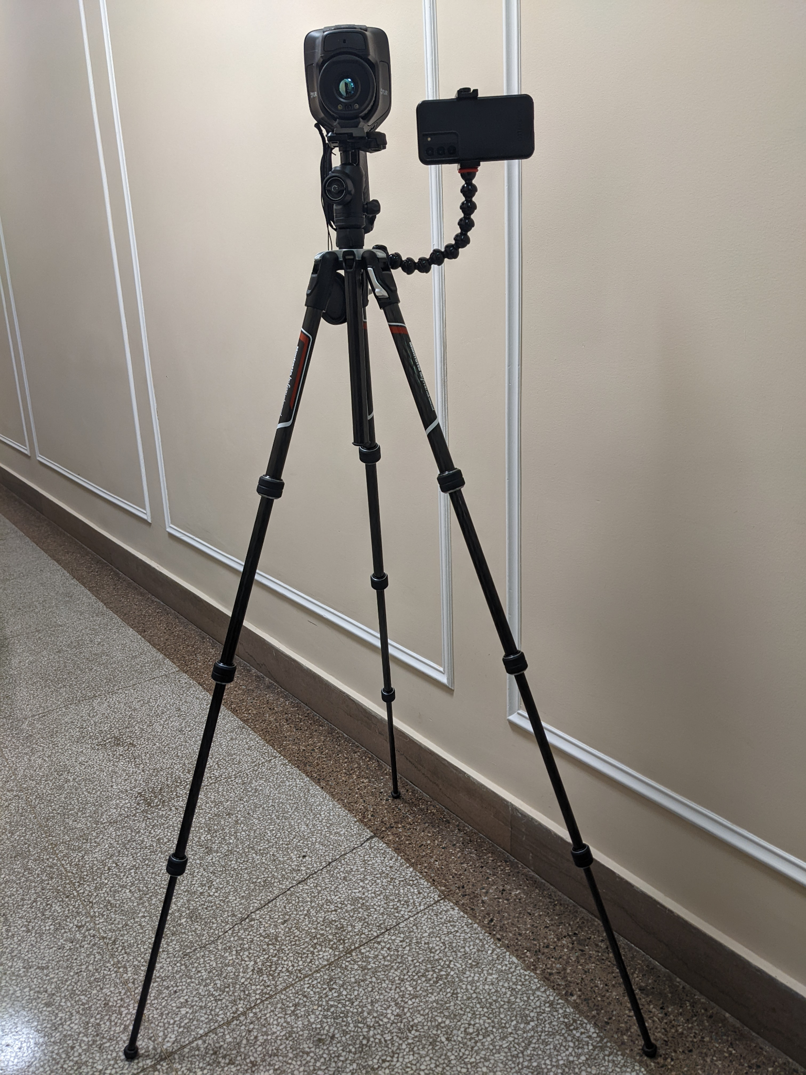
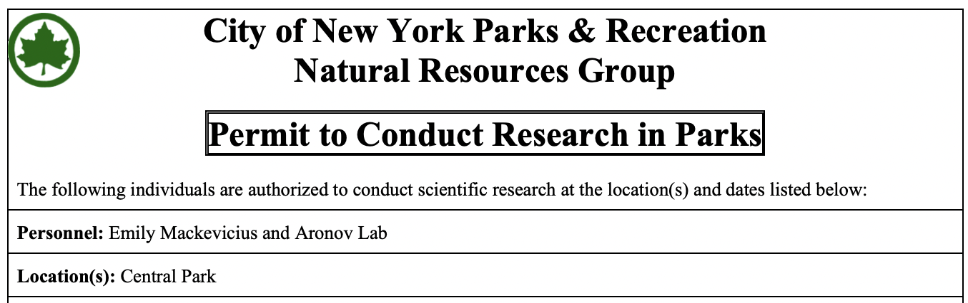
Observing multiple species of birds in Central Park
Thermal (IR) camera
RGB camera

Slide 6
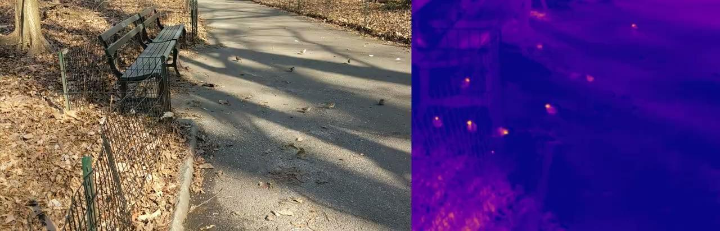
This video has 4 species (WTSP, TUTI, HOSP, BLJA), and at least 2 more (MODO, NOCA) were in the group

Slide 7
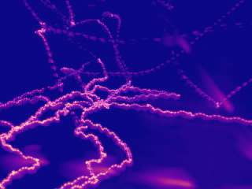

Slide 8

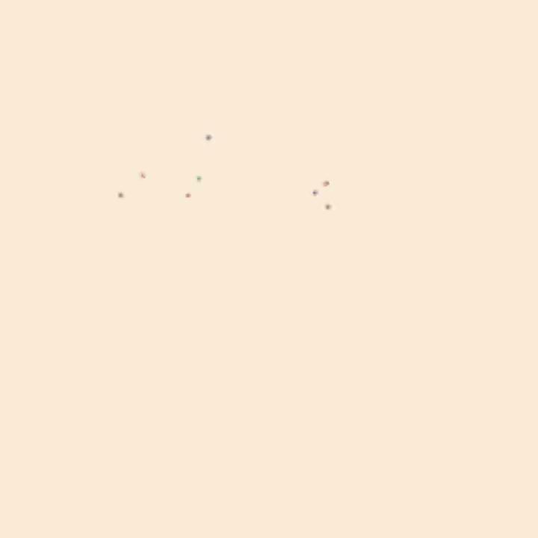
Behaviors of across multi-species groups

Slide 9
Code demos and exercises…
https://github.com/emackev/multi_agent_exercises

Slide 10
Multi-agent behavior, week 2
Comparing different types of agents
Braitenburg Vehicles
Cellular Automata
Practice visualizing data in MATLAB
Make an app!

Slide 11
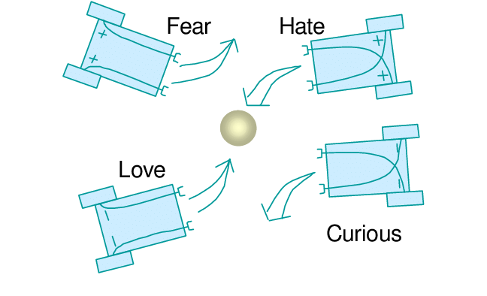
Braitenberg Vehicles

Slide 12
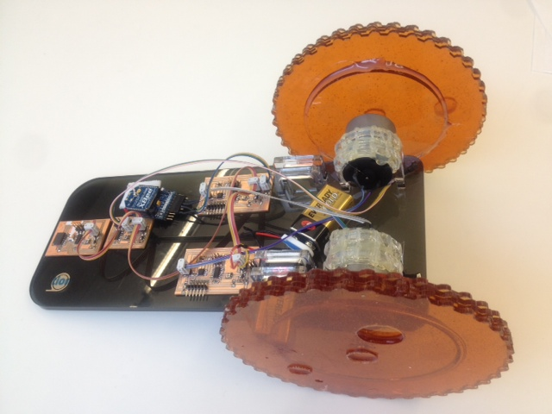
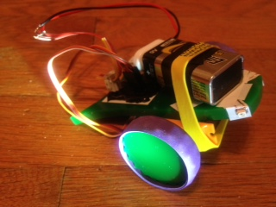
Braitenberg Vehicles
https://fab.cba.mit.edu/classes/863.12/people/mackevicius/WK11.html
https://fab.cba.mit.edu/classes/863.12/people/mackevicius/WK15.html

Slide 13
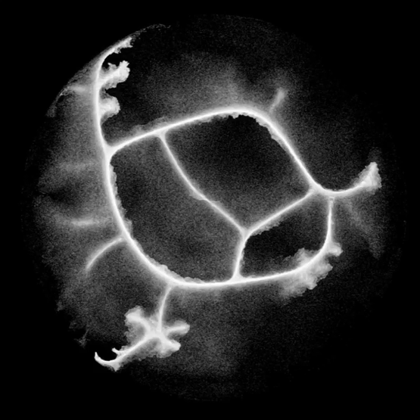
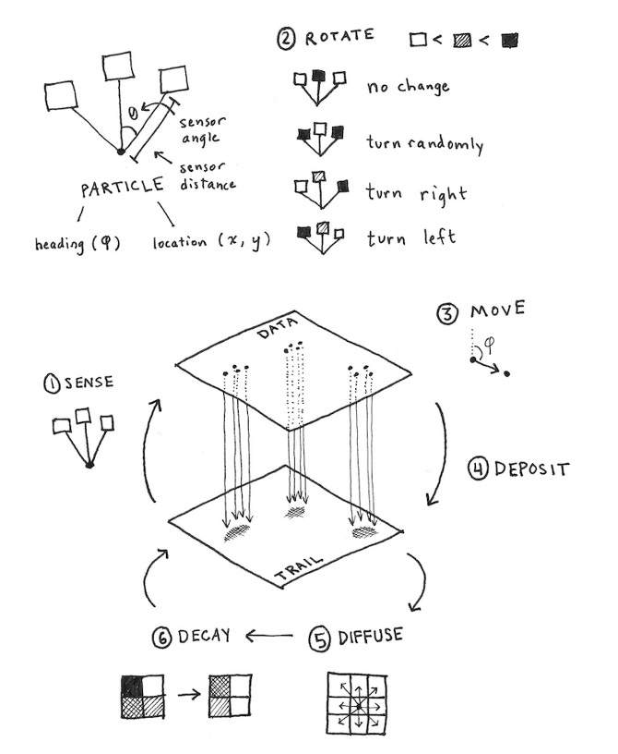
Cellular automata
https://cargocollective.com/sagejenson/physarum

Slide 14
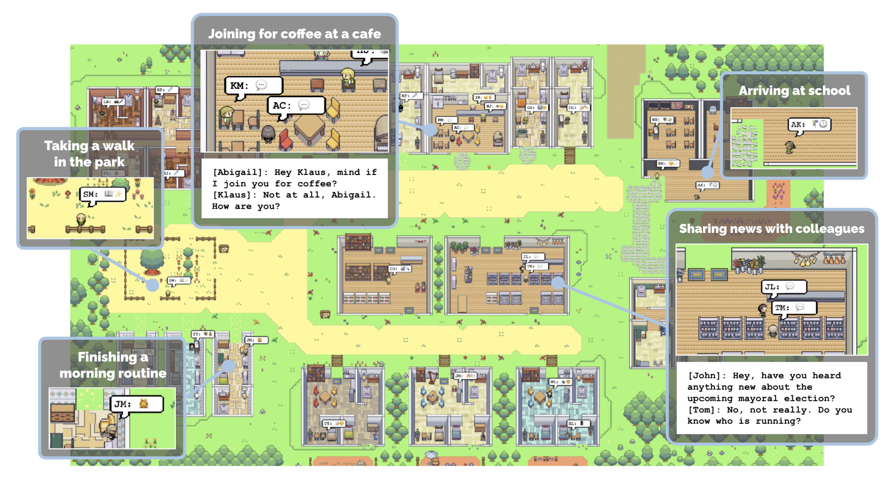
Multi-agent simulations, aided by LLMs
Park et al., https://github.com/joonspk-research/generative_agents
See also recent work from Robert Yang’s group

